Slide 1
Pennsylvanians’ Perceptions of Police Body Worn Cameras
Jennifer Gibbs, School of Public Affairs
Tim Servinsky, Center for Survey Research

Slide 2
Timeline of selected police killings with PA residents’ attitudes toward police
80-86% have at least some confidence in police
88% have positive opinion of local police
79% believe police can be trusted
2012
2013
2014
2015
2016
2/26/12
Trayvon Martin: Sanford, FL
7/17/14
Eric Garner: NYC
4/7/15
Walter Scott: N. Charleston, SC
7/5/16
Alton Sterling: Baton Rouge, LA
8/9/14
Michael Brown: Ferguson, MO
4/19/15
Freddie Gray: Baltimore, MD
7/6/16
Philando Castile: Falcon Heights, MN
11/22/14
Tamir Rice: Cleveland, OH
Notes:
Findings from these surveys:
Crime & Justice Poll (Spring 2014): 80-86% of PA residents have at least some confidence in police to protect them from violent crime (80%) & solve crime (86%)
Penn State Poll (Spring 2015): 88% have positive opinion of local police; 91% believe local police are “legitimate”
Penn State Poll (Fall 2016): 79% agreed to the statement, “The police can be trusted to make decisions that are right for your community”; 82% believe local police are “legitimate”
OVERALL: PA citizens like their police! But, in the wake of high profile police shootings, the public is calling for greater police accountability.

Slide 3
PA residents’ attitudes toward police by race-ethnicity
2014 2015 2016

Slide 4
Benefits of police body worn cameras
Opportunity for police transparency
May reduce complaints against police
May affect use of force (mixed evidence)
  Evidence of INCREASED force
  when officers have discretion to record
Increases arrests/citations
Assists judges’ decision-making

Slide 5
Concerns of police body worn cameras
What makes body cams different than dash cams?
Police discretion to turn off cameras
Effectiveness is nuanced
Storage
  By whom?
  (Police v. private contractor)
  How long?
  Who has access to footage?
Cost
Releasing footage to public
  To whom?
  When?
Technology malfunctions
Fewer tips to police because people afraid to be recorded

Slide 6
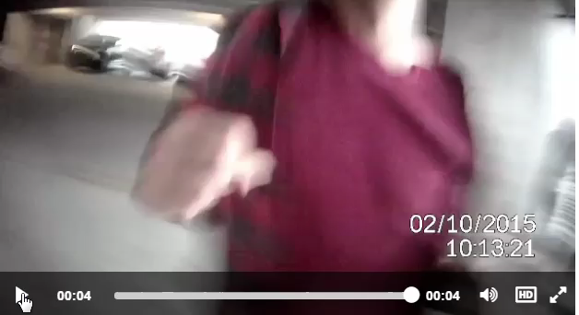
Concerns of BWC
Consider this BWC footage:
Video source:
https://www.nytimes.com/interactive/2016/04/01/us/police-bodycam-video.html?_r=1

Slide 7
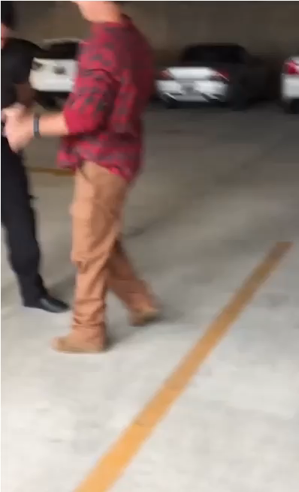
Concerns of BWC
Public expectations may be too high
BWC footage will only tell part of story
Video source: https://www.nytimes.com/interactive/2016/04/01/us/police-bodycam-video.html?_r=1

Slide 8
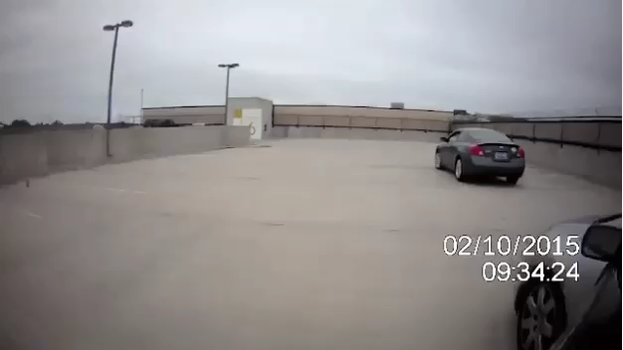
Concerns of BWC
Consider this BWC footage:
Video source:
https://www.nytimes.com/interactive/2016/04/01/us/police-bodycam-video.html?_r=1

Slide 9
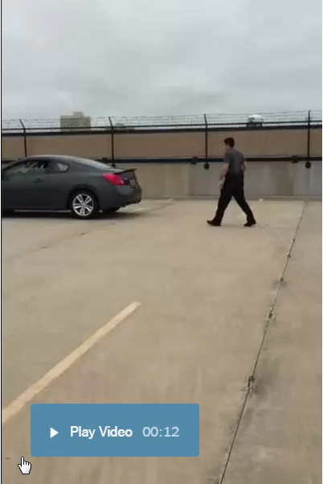
Concerns of BWC
Public expectations may be too high
BWC footage will only tell part of story
Video source: https://www.nytimes.com/interactive/2016/04/01/us/police-bodycam-video.html?_r=1

Slide 10
Research Question
Given the drawbacks,
are the benefits
of BWC enough
to make PA residents
feel safer?

Slide 11
Current study: Methods
Penn State Poll Omnibus Telephone Survey:
  Conducted by the Penn State Harrisburg Center for Survey Research
  Administered September 8 to October 29, 2016
  Random sample of 605 adult Pennsylvanians
  Two-stage sampling procedure

Slide 12
Sampling: Stage 1
Dual-Frame Sample: Landline and Cell
  Representative Random Digit Dial (RDD) samples
  Equal Probability of Selection Method (EPSEM)
    Randomly generates numbers from known telephone prefixes
    Every phone line in PA has equal chance of selection
  Numbers drawn proportionally to estimated population in each county

Slide 13
Sampling: Stage 2
Landline only
  Household randomization technique:
  Last Birthday Method
  Person in the household 18+ who last celebrated a birthday
  Provides a more even distribution of responses by gender

Slide 14
Response Overview
605 responses received
  52.6% Landline
  Margin of Sampling Error: 3.2%
  28,000+ calls made
  Cooperation Rate: 61.3%
    # Interviews / (# Interviews + # Partial Interviews + # Refusals)

Slide 15
Data
Dependent variable:
I would feel safer if a police officer was wearing a video camera (for example, a body cam).
1= Strongly agree
2= Agree
3= Disagree/strongly disagree
Predictor variables:
Racial minority (=1; White= 0)
Men (=1; 0= women)
Age
Education
  1= high school diploma or less
  2= some college
  3= college degree
  4= graduate work
Income
  1= Less than $30K
  2= $30K-$59,999
  3= $60K-$99,999
  4= $100K or more
Political affiliation
  1= Republican
  2= Democrat
  3= Other (independent, Libertarian…)
Urban (=1; rural= 0)

Slide 16
Post-Stratification Weighting
Adjustments made to final dataset
Representative by age/sex
Value assigned to each case
Each response is multiplied by that value

Slide 17
 | Interviewed | Expected | Weight Factor
Male
18-24 years | 22 | 36.506 | 1.65938
25-34 years | 26 | 50.370 | 1.93731
35-44 years | 42 | 44.678 | 1.06375
45-54 years | 49 | 52.343 | 1.06823
55-64 years | 69 | 52.111 | 0.75523
65-74 years | 53 | 33.439 | 0.63093
75 years and over | 39 | 22.949 | 0.58844
Female
18-24 years | 15 | 35.559 | 2.37060
25-34 years | 20 | 49.129 | 2.45644
35-44 years | 32 | 45.024 | 1.40699
45-54 years | 44 | 53.772 | 1.22209
55-64 years | 75 | 55.095 | 0.73460
65-74 years | 61 | 38.153 | 0.62546
75 years and over | 58 | 35.872 | 0.61848

Slide 18
Sample (n = 581)
Item | % Survey | % Survey Weighted | % PA (18+) | Item | % Survey |  | % Survey Weighted | % PA (18+)
Race |  |  |  | Income
Racial minority | 14.0% | 16.4% | 16.1% | Less than $30K | 24.7% |  | 20.7% | n.d.
White | 86.0% | 83.6% | 83.9% | $30K-$59,999 | 24.3% |  | 24.8%
 |  |  |  | $60K-$99,999 | 22.8% |  | 23.7%
Sex |  |  |  | $100K or more | 28.2% |  | 30.8%
Men | 49.6% | 48.3% | 48.3%
 |  |  |  | Political affiliation
Age |  |  |  | Republican |  | 39.1% | 36.5% | 38.3%
Mean (st. dev.) | 56 (17.6) | 49 (18.4) | 40 | Democrat |  | 34.9% | 34.0% | 47.9%
 |  |  |  | Other |  | 26.0% | 29.4% | 13.8%
Education | % Survey | % Survey Weighted | % PA (25+)
High school/less | 23.6% | 22.1% | 47.2% | Geography
Some college | 35.7% | 35.7% | 24.2% | Urban |  | 68.6% | 70.5% | 73.3%
College degree | 20.2% | 22.4% | 17.4%
Graduate work | 20.6% | 19.9% | 11.2%

Slide 19
“I feel safer when police wear body cameras” (n = 581)

Slide 20
I would feel safer if a police officer was wearing a video camera…
(χ²₍₄₎ = 16.601, p= 0.002)

Slide 21
I would feel safer if police wore body cameras.
 | Strongly agree (v. A & D) | Agree (v. SA & D)
Racial Minority |  | n.s.
Men | n.s.
Age | n.s. | n.s.
Education
Some college | n.s. | n.s.
College degree | n.s. | n.s.
Graduate work | n.s. | n.s.
Income
Under $30,000 | n.s. | n.s.
$30K-$59,999 | n.s.
$60K-$99,999 | n.s. | n.s.
Political affiliation
Democrat
Other | n.s. | n.s.
Urban | n.s.
Note: reference categories are high school, >$100K, and Republican.

Slide 22
Findings: Who feels safer with BWC?
Racial minorities
Democrats
Women
Low income
Those living in urban areas

Slide 23
Recommendations
Police agencies should set clear guidelines for BWC use
  Limit officer discretion on when to use
  Consistently demonstrate fair response to violations
Beware of cutting community policing efforts to fund BWC programs

Slide 24
Recommendations
Policymakers should help temper public expectations of police BWC
  BWC footage will only tell part of story

